Slide 1
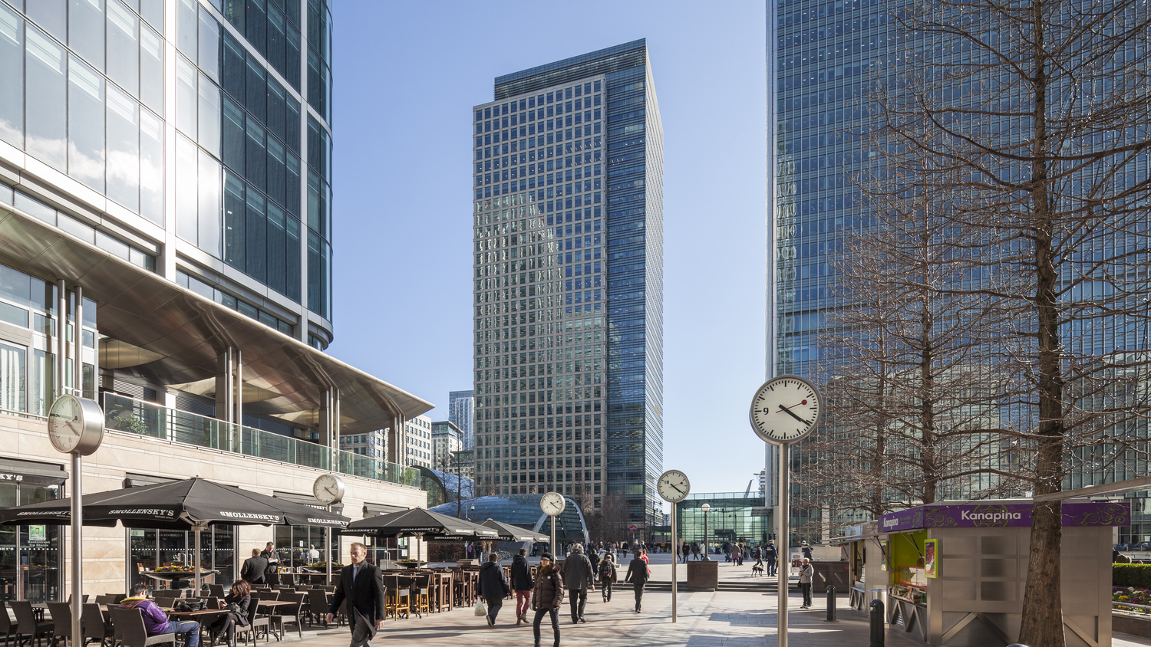

40 Bank Street
Architecture, Built / Complete, Corporate Offices, Finance, Hotel, Interior Design, London, Office, Silver, Skyscraper, Structural Engineering, UK

Slide 2
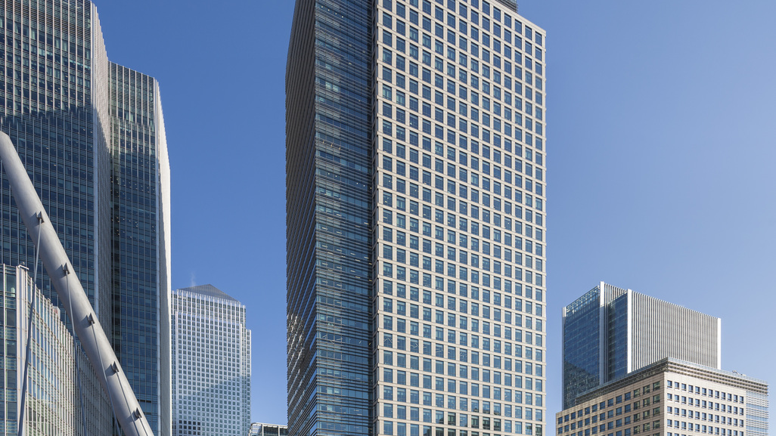
40 Bank Street
Architecture, Built / Complete, Corporate Offices, Finance, Hotel, Interior Design, London, Office, Silver, Skyscraper, Structural Engineering, UK

Slide 3
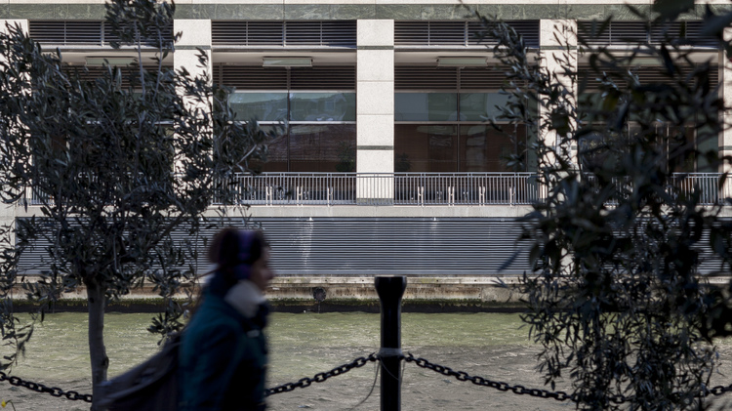
40 Bank Street
Architecture, Built / Complete, Corporate Offices, Finance, Hotel, Interior Design, London, Office, Silver, Skyscraper, Structural Engineering, UK

Slide 4
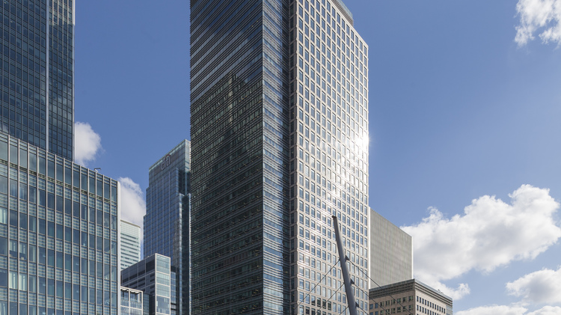
40 Bank Street
Architecture, Built / Complete, Corporate Offices, Finance, Hotel, Interior Design, London, Office, Silver, Skyscraper, Structural Engineering, UK

Slide 5
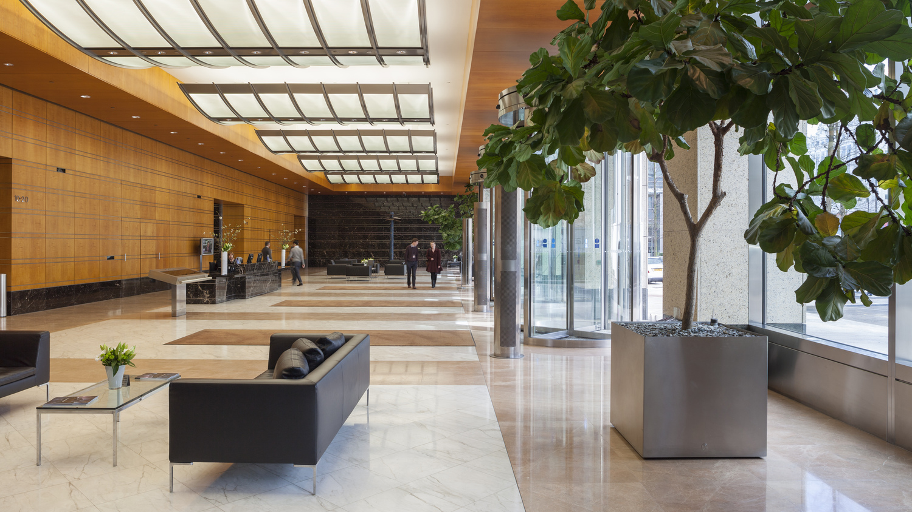
40 Bank Street
Architecture, Built / Complete, Corporate Offices, Finance, Hotel, Interior Design, London, Office, Silver, Skyscraper, Structural Engineering, UK

Slide 6
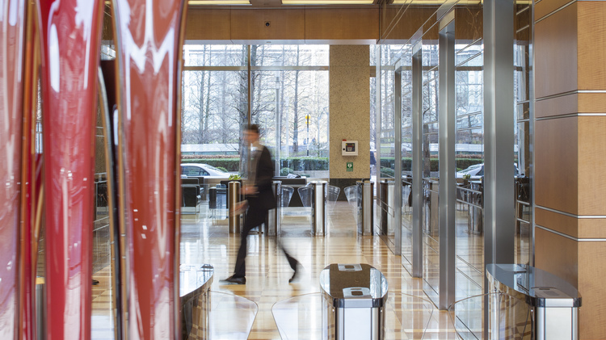
40 Bank Street
Architecture, Built / Complete, Corporate Offices, Finance, Hotel, Interior Design, London, Office, Silver, Skyscraper, Structural Engineering, UK

Slide 7
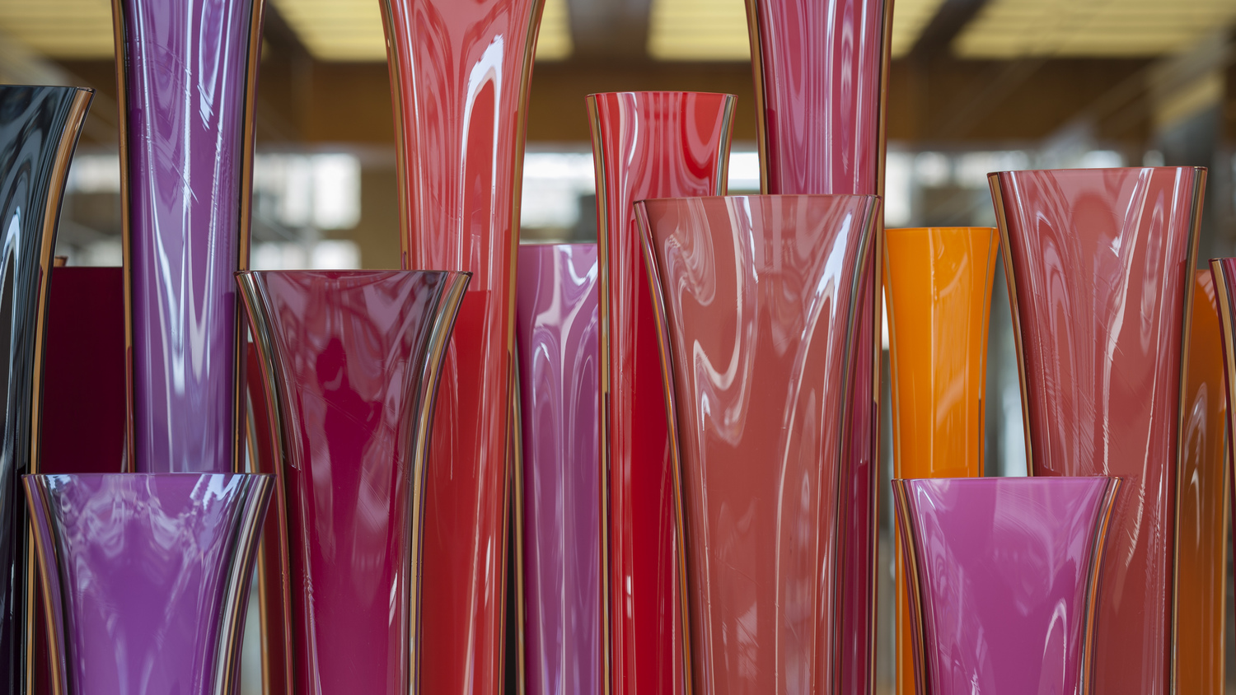
40 Bank Street
Architecture, Built / Complete, Corporate Offices, Finance, Hotel, Interior Design, London, Office, Silver, Skyscraper, Structural Engineering, UK

Slide 8
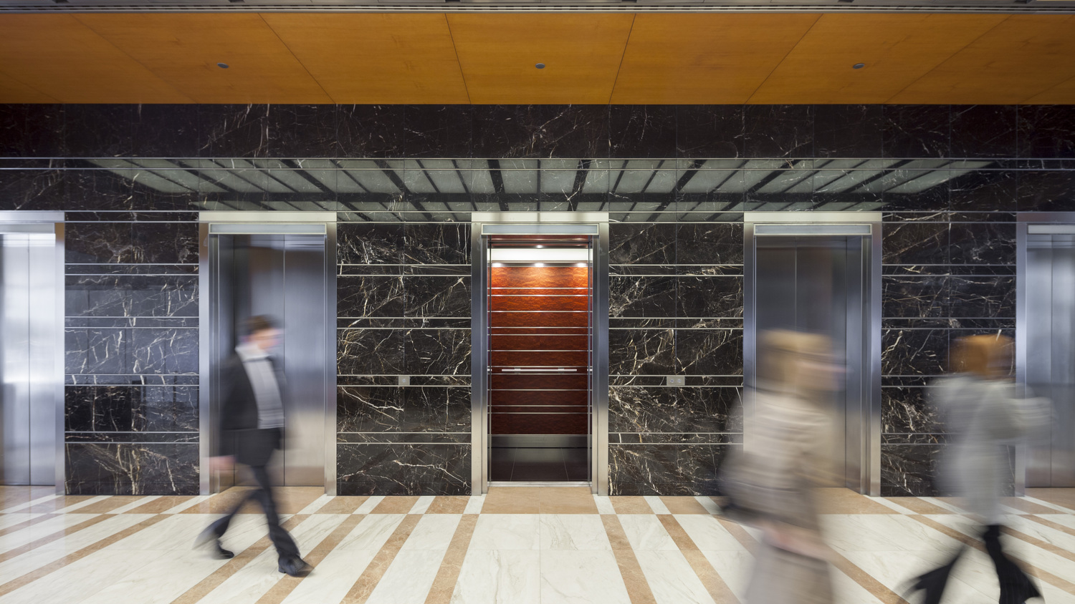
40 Bank Street
Architecture, Built / Complete, Corporate Offices, Finance, Hotel, Interior Design, London, Office, Silver, Skyscraper, Structural Engineering, UK

Slide 9
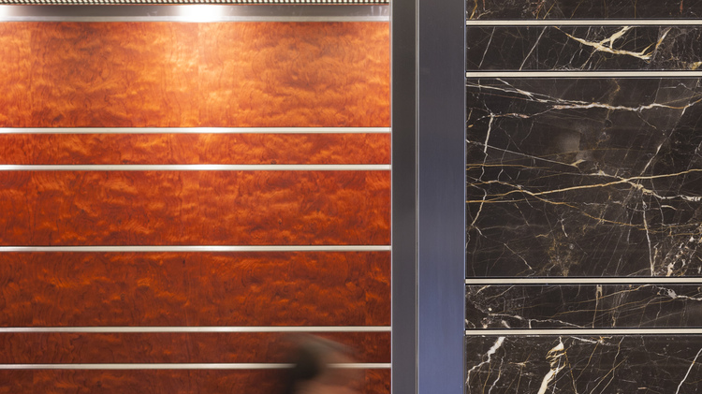
40 Bank Street
Architecture, Built / Complete, Corporate Offices, Finance, Hotel, Interior Design, London, Office, Silver, Skyscraper, Structural Engineering, UK

Slide 10
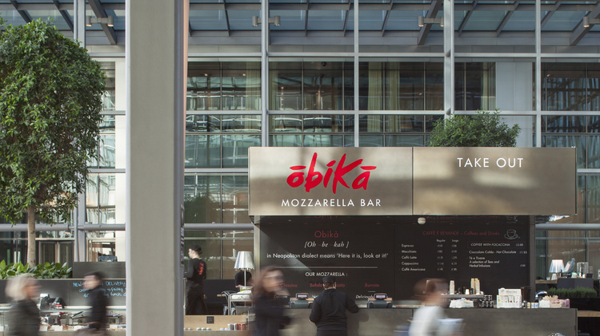
40 Bank Street
Architecture, Built / Complete, Corporate Offices, Finance, Hotel, Interior Design, London, Office, Silver, Skyscraper, Structural Engineering, UK

Slide 11
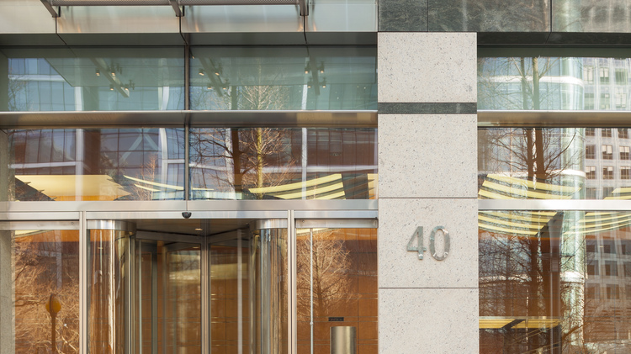
40 Bank Street
Architecture, Built / Complete, Corporate Offices, Finance, Hotel, Interior Design, London, Office, Silver, Skyscraper, Structural Engineering, UK

Slide 12
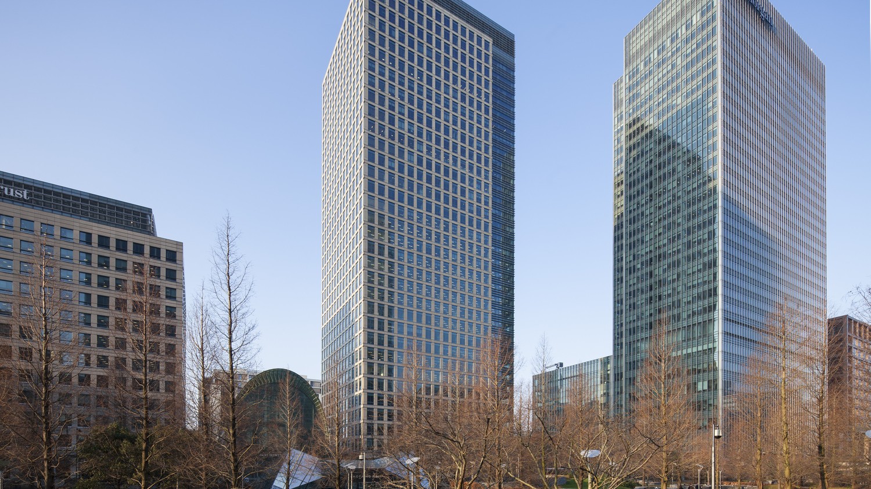
40 Bank Street
Architecture, Built / Complete, Corporate Offices, Finance, Hotel, Interior Design, London, Office, Silver, Skyscraper, Structural Engineering, UK

Slide 13
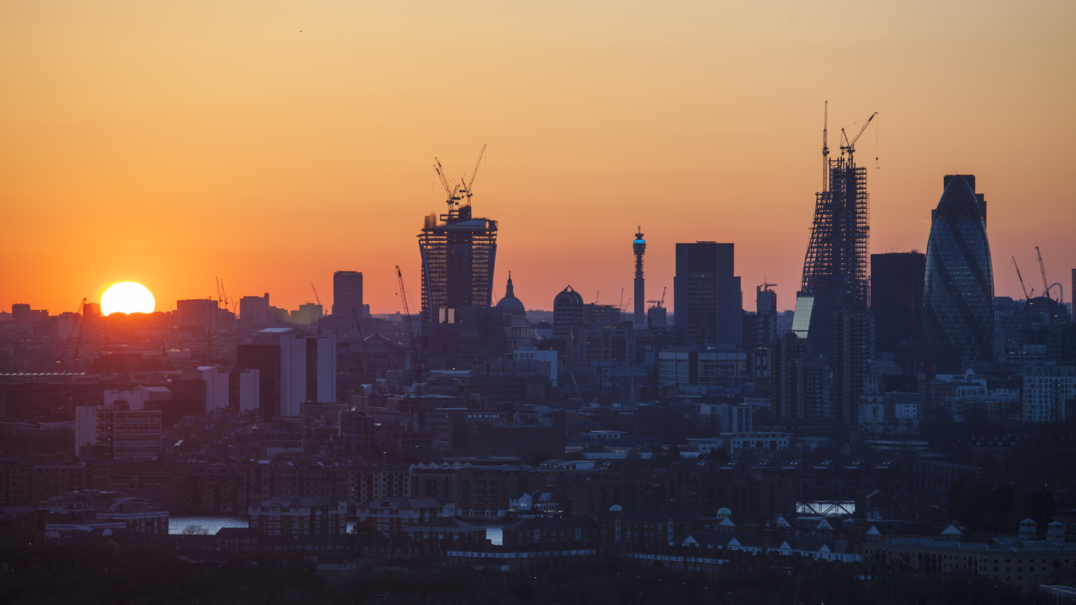
40 Bank Street
Architecture, Built / Complete, Corporate Offices, Finance, Hotel, Interior Design, London, Office, Silver, Skyscraper, Structural Engineering, UK

Slide 14
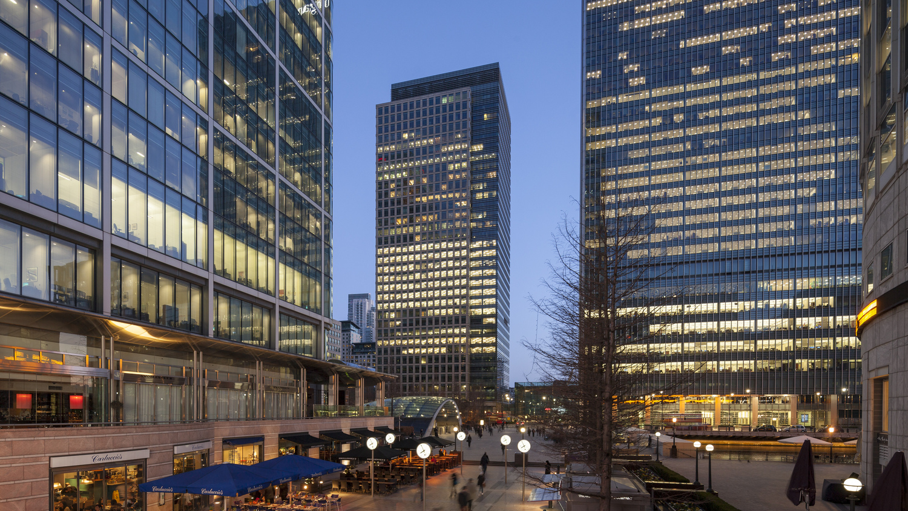
40 Bank Street
Architecture, Built / Complete, Corporate Offices, Finance, Hotel, Interior Design, London, Office, Silver, Skyscraper, Structural Engineering, UK

Slide 15
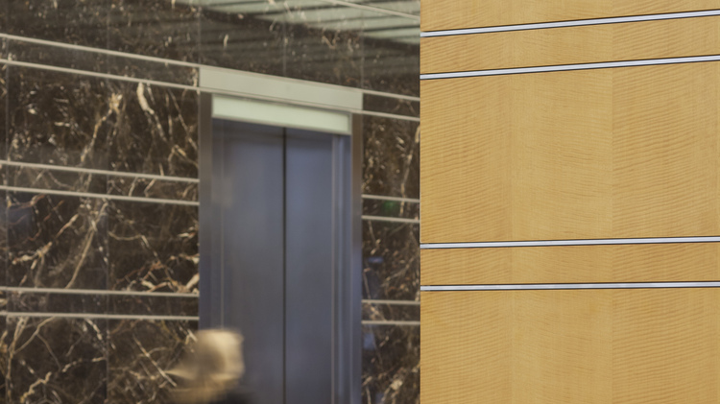
40 Bank Street
Architecture, Built / Complete, Corporate Offices, Finance, Hotel, Interior Design, London, Office, Silver, Skyscraper, Structural Engineering, UK

Slide 16
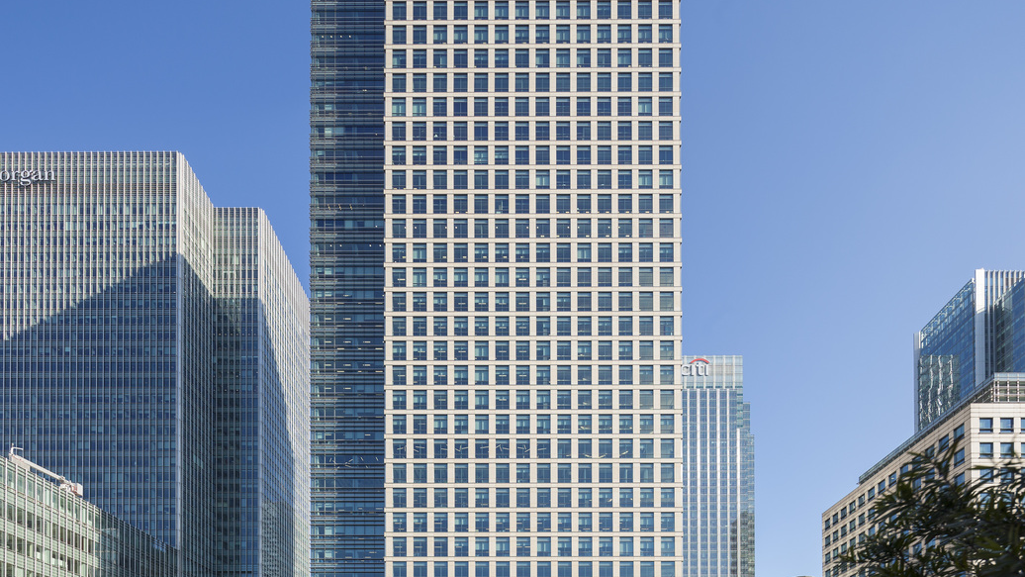
40 Bank Street
Architecture, Built / Complete, Corporate Offices, Finance, Hotel, Interior Design, London, Office, Silver, Skyscraper, Structural Engineering, UK

Slide 17
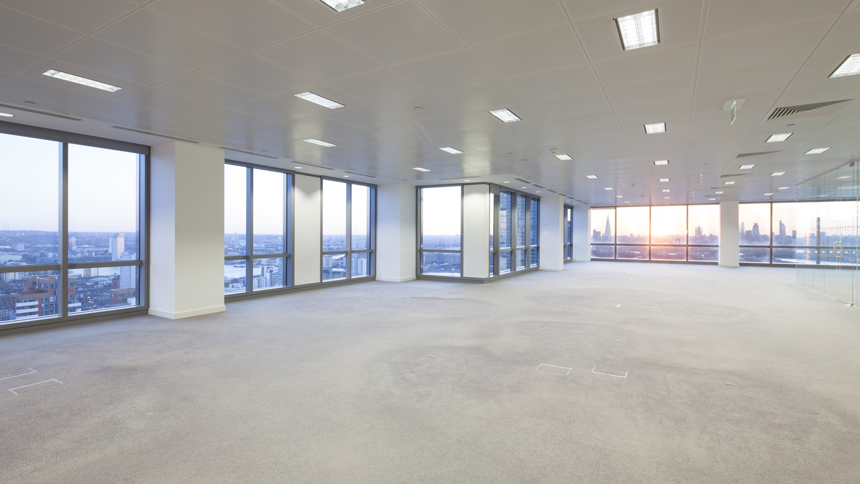
40 Bank Street
Architecture, Built / Complete, Corporate Offices, Finance, Hotel, Interior Design, London, Office, Silver, Skyscraper, Structural Engineering, UK

